Slide 1
Date: 31.03.21
V. KEERTHIVASAN 2018A8PS0480P
KESHAV TAWARI 2017B3A30511P
VEDANT CHAUDHARI 2018A8PS0353P
YASH JHA 2017B3A30603P
VISHWANATHA ISHAN 2017B3A80520P
Presentation
Real Time Analysis of EEG Signal Using FPGA
Supervisor : Prof. Yenuganti Sujan
Department of Electrical Engineering

Slide 2
Introduction
EEG
Introduced in 1924, Electroencephalography (EEG) is serving the healthcare industry for diagnosing various diseases.
EEG is the physiological approach of choice to record the brain's electrical activity via electrodes placed on the scalp surface.
EEG is one of the quickest imaging-techniques, as it often has a high sampling rate.

Slide 3
Introduction
FPGA
The field-programmable gate array (FPGA) is an integrated circuit consisting of internal hardware blocks with user-programmable interconnects to customize operation for a specific application.
FPGAs are particularly useful for prototyping application-specific integrated circuits (ASICs) or processors.
FPGA based implementation of EEG
FPGA based implementation of EEG allows better optimization of workflow.
It enables making any possible iteration at the chip level throughout experimentation.
It proves to be more cost efficient.

Slide 4
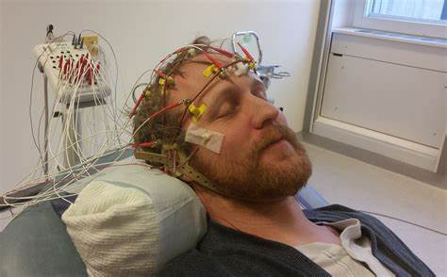
DECIPHERING THE EEG SIGNAL
EEG SIGNAL RECORDING
PRE - PROCESSING
FEATURE EXTRACTION
CLASSIFICATION

Slide 5
EEG SIGNAL RECORDING
The recordings of the EEG signal are obtained by connecting cup electrodes or scalp discs on the scalp.
The scalp is prepared beforehand by light abrasion to decrease the resistance caused due to light skin cells.
Then the conducting gel is applied to the scalp, followed by attaching the electrodes to the head.
The sampling occurs between 256- 512 Hz for Analog to digital conversion.

Slide 6
DATA PREPROCESSING
Filtering operation by FIR filter
Wavelet decomposition needs additional processing to extract specific frequency bands of EEG signal.
The frequency range of the five EEG sub-bands is delimited between 8-60 Hz and higher frequencies are considered as noise. Therefore, to obtain more easily the frequency sub-bands of the EEG during the wavelet analysis, the EEG is band-limited to 0–64Hz range by convolving with a low-pass finite impulse response (FIR) filter.

Slide 7
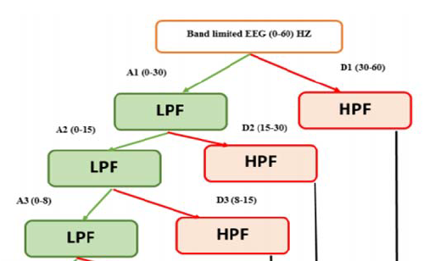
NOISE
ALPHA
BETA
GAMMA

Slide 8
FEATURE EXTRACTION
Important so as to unravel the complexity of the signal, to further compress the data and reduce the cost of maintaining the information.
The features extracted using DWT are : i)Maximum and minimum amplitude, ii)Mean, iii)Standard deviation, iv)the energy percentages of the wavelets and its details.
DOMAIN | MODELS IN THE DOMAIN | ACCURACY
TIME | FAST FOURIER TRANSFORM | 91%
TIME | DISCRETE WAVELET TRANSFORMATION | 93.33%
WAVELET | NEURAL NETWORKS | 97-98%

Slide 9
Feature extraction based on discrete wavelet transform(DWT)
Discrete Wavelet Transformation (DWT) is used. Using db4 wavelet transform, first the signal is differentiated into two groups using High pass filters and low pass filters, into 0-30 Hz and 30-60 Hz, The method is repeated three times
1. alpha (8-15 Hz)
2. beta (15-30 Hz)
3. gamma (30 – 60 Hz)

Slide 10
CLASSIFICATION
We require efficient classification techniques to properly distinguish the EEG segments based on the acquired data and help in the making the decisions on the person’s health.
TYPE | CLASSIFIER | MISCELLANEOUS
LINEAR | Linear Discriminant Analysis, Support Vector Methods | Use hyperplanes to classify and separate the data. Give poor outcomes to nonlinear complex data.
NEURAL NETWORKS | ANTMINER+ | Comes under Ant Colony Optimization (ACO) keeps working on improving the levels classification from the classified data.
NON-LINEAR BAYER | Hidden Markov Bayes Quadratic | Efficient in rejecting uncertain samples than other classifiers
NEAREST NEIGHBOUR | Mahalanobis Distance, K Nearest Neighbour | Perform accurately even with low dimensional Feature Vectors

Slide 11
LITERATURE REVIEW
Ozpolat, E., Karakaya, B., Kaya, T., & Gulten, A. (2016, April) highlights FPGA-based digital Filter Design for Biomedical Signal. This paper presents a Field Programmable Gate Array (FPGA)-based Fir Filter Design for Biomedical signal processing.The focus of this paper is to compute FIR filter coefficients on MATLAB Filter Design Toolbox and then transfer them to embedded design on FPGA to filter EEG signal.
Sundaram, K. (2016, March) talks about FPGA-based filters for EEG pre-processing. In this paper, filters such as Moving average and Median filter are implemented in FPGA (Virtex-5) and compared in terms of area, power, and delay.
Subha, D. P., Joseph, P. K., Acharya, R., & Lim, C. M. (2010) gives details about EEG signal analysis. In this paper, the effect of different events on the EEG signal and different signal processing methods used to extract the hidden information from the signal are discussed in detail. Linear, Frequency domain, time-frequency, and non-linear techniques like correlation dimension (CD), largest Lyapunov exponent (LLE), Hurst exponent (H), different entropies, fractal dimension(FD), Higher-Order Spectra (HOS), phase space plots, and recurrence plots are discussed in detail using a typical normal EEG signal.
J. C. R., & Huamaní-Navarrete, P. F. (2020, October) presents a Design and Simulation of a Digital Filter with Finite Impulse Response in Hardware for electroencephalographic (EEG) signals based on Field Programmable Gate Array (FPGA). The Modelsim and Matlab software were used for the design and simulation stage of digital filter and the Hamming and Blackman windows for the design of the filter.

Slide 12
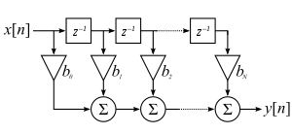
Preprocessing of EEG signal using FIR Filter in FPGA
The above architecture of FIR filter is implemented in FPGA for segregrating the EEG signal into Alpha , Beta and Gamma waves in time domain
X[n] is the input EEG signal
We represent it by taking 12 bits without the decimal point and finally we take the decimal point into account in the end result.
b0, b1, b2……..bn are the coefficients of the FIR Filter of Hamming window. They are computed in MATLAB and fed to Vivado for computation of output signal.
The hamming window coefficients are converted to 12 bit binary values and these values without the decimal point are taken and multiplied with X[n] and finally the powers are added along with the multiplied result to get the final result.

Slide 13
Preprocessing of EEG signal using FIR Filter in FPGA(Continuation )
Since each sample is of 12 bits and coefficients is also of 12 bits, the resulting computation requires 24 bits
Since the order is 16 ( requires 5 bits), each resulting value is added with the partial product from other coefficients . resulting in 29 bits( 24 + 5 ).
From This resulting 29 bits the decimal point is kept at 5 places from left.
In each clock cycle computation is done ( multiplication and addition as shown in the architecture) to find Y[n] at that clock cycle.
As the clock count increases, the input values move from left to right .
The Architecture shown before introduces the Z^-1 block which introduces the delay.
So therefore the convolution of input signal with the Filter coefficients is done effectively to form the FIR FIlter.
Results from verilog are fed into MATLAB to visualize Alpha,Beta and Gamma signals (Shown in report)

Slide 14
Thank You

